Slide 1

SUBJECT : EX-EED BRANCH : CSE-(DATA SCIENCE) IDEA : AUTO VOLUME ADJUSTMENT BY GESTURES
SUBMITTED BY :
M.THARUN GOUD – 22951A67F5
D.YESHWANTH – 22951A6720
K. Teja – 22951A67F4

Slide 2
PROLEM STATEMENT :
In the realm of audio consumption, users often face challenges with the manual adjustment of volume settings, especially in dynamic environments where background noise levels fluctuate. Traditional methods, such as using physical buttons or on-screen sliders, can be cumbersome and distracting, particularly in situations where hands-free operation is desirable. To address this issue, there is a need for an innovative solution that leverages gesture recognition technology to enable seamless and automatic volume adjustment in real-time. The challenge lies in developing a robust and accurate system that can interpret user gestures effectively, ensuring a natural and intuitive audio control experience while accounting for various environmental factors and minimizing false positives/negatives. This problem statement aims to inspire the creation of an Auto Volume Adjustment by Gestures system that enhances user convenience and comfort in diverse audio settings.

Slide 3
PROPOSED SOLUTION :
Auto volume adjustment by gestures is an interesting idea that can enhance user experience and convenience. Here's a proposed solution for implementing this feature:
1. Gesture Recognition System:
Implement a robust gesture recognition system using a combination of cameras and/or sensors. This system should be capable of recognizing common hand gestures such as swiping up, swiping down, or circular motions.
2. Sensor Integration:
Integrate sensors, such as accelerometers or gyroscopes, into the device to capture motion data accurately. This data will be crucial for recognizing and interpreting user gestures.
3. Machine Learning Model:
Train a machine learning model to recognize specific gestures associated with volume adjustments. Use a dataset that includes a variety of gestures and corresponding volume levels to improve the model's accuracy.
4. Calibration Process:
Implement a calibration process during the initial setup to customize the system according to individual users' preferences. This process can involve users performing gestures at different volumes to establish a baseline for gesture-to-volume mapping.
5. Real-time Gesture Analysis:
Continuously analyze gestures in real-time to detect changes in the user's intention to adjust volume. Implement algorithms that filter out unintended gestures and noise to ensure accurate volume adjustments.

Slide 4
UNIQUENESS OF THE IDEA :
One unique aspect of the auto volume adjustment by gestures idea could be the incorporation of "Contextual Gesture Recognition." This involves tailoring the gesture recognition system to interpret gestures differently based on the context in which they are performed.
Here's how it could work:
Context Awareness:
The system analyzes the context in which the user is making gestures. For example, it takes into account the user's location, activity, and even the type of content being consumed (e.g., music, video, phone call).
Adaptive Gesture Mapping:
The system dynamically adapts the meaning of gestures based on the context. A certain gesture may increase volume during music playback but could be assigned a different function, such as skipping tracks, during video playback.
Learning Algorithms:
Implement machine learning algorithms that continuously learn and adapt to user behavior in different contexts. Over time, the system becomes more accurate in predicting the user's intent based on the context in which gestures are performed.

Slide 5
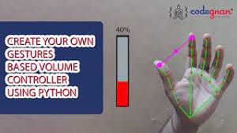
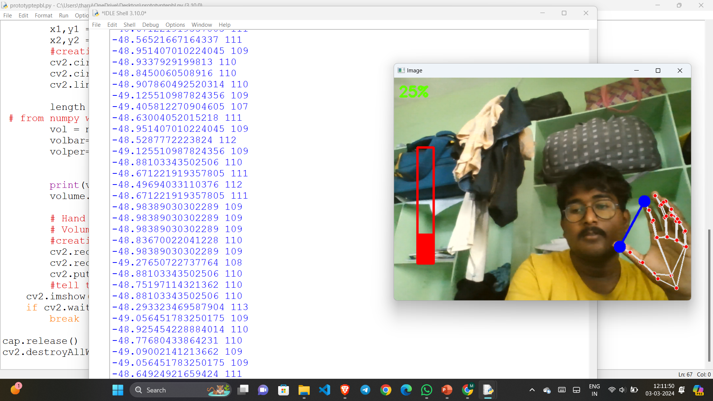
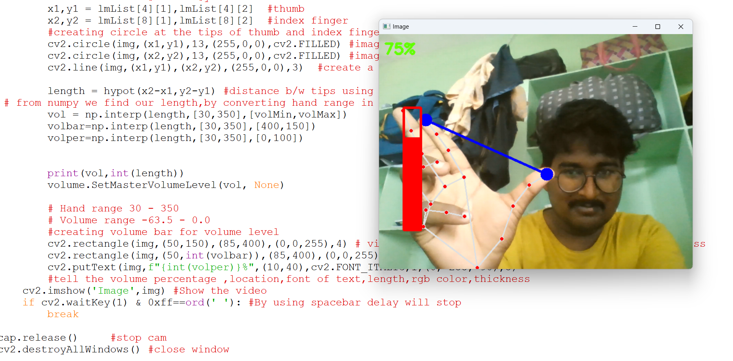

Slide 6
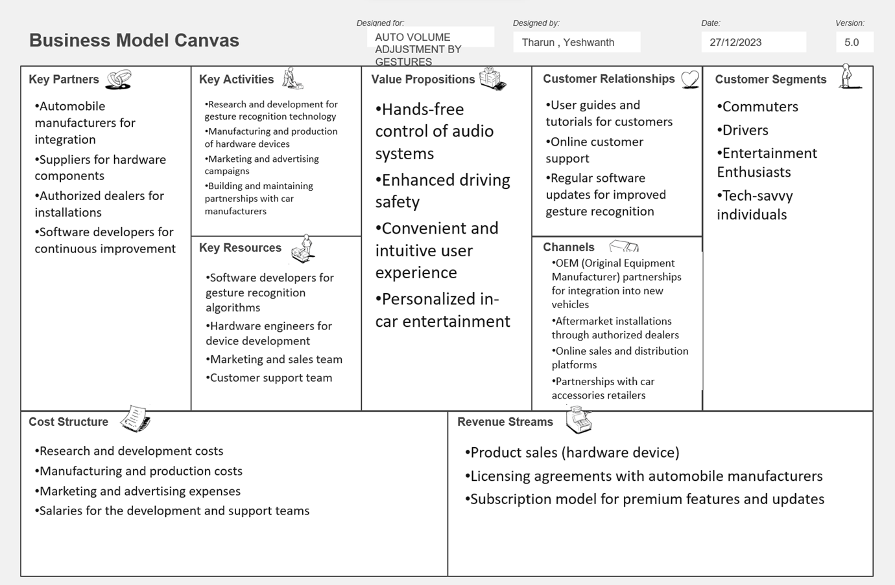

Slide 7
CONCLUSION :
In conclusion, the concept of auto volume adjustment by gestures introduces an innovative and user-friendly approach to enhancing the audio experience. The integration of gesture recognition technology not only provides a hands-free and intuitive means of controlling volume but also opens the door to a range of possibilities for personalization and adaptability. By incorporating contextual awareness, learning algorithms, and adaptable sensitivity, this idea ensures that volume adjustments are not only accurate but also seamlessly aligned with the user's preferences and the surrounding environment.
The proposed solution, encompassing a robust gesture recognition system, machine learning models, and a thoughtful calibration process, aims to create a sophisticated yet user-friendly experience. The emphasis on feedback mechanisms, privacy considerations, and user customization provides a well-rounded approach to cater to diverse user preferences and scenarios. Furthermore, the unique aspect of contextual gesture recognition adds an extra layer of sophistication, allowing the system to intelligently adapt to different usage contexts and user activities.

